Slide 1
LMY Home Exercise
Summary
Inga Paster
20/07/2025

Slide 2
Task 1: Semantic Segmentations of Paris’ Buildings

Slide 3
Task 1.1 : Data Analysis

Slide 4
Data Source
Data Source: https://spacenet.ai/paris/
https://spacenet-dataset.s3.amazonaws.com/spacenet/SN2_buildings/tarballs/SN2_buildings_train_AOI_3_Paris.tar.gz

Slide 5
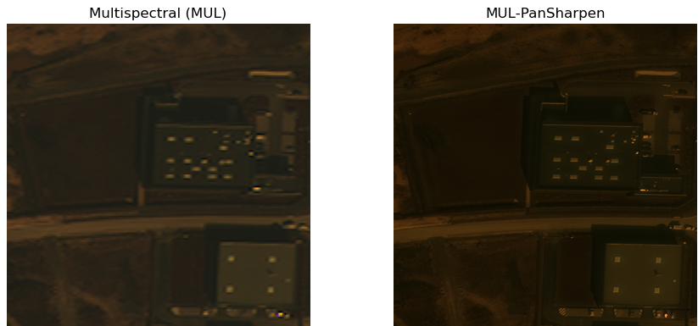
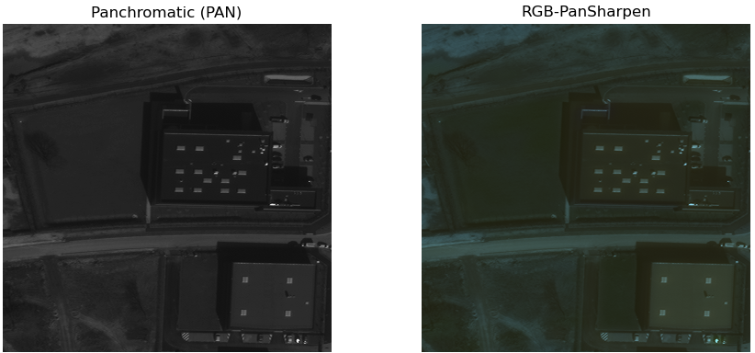
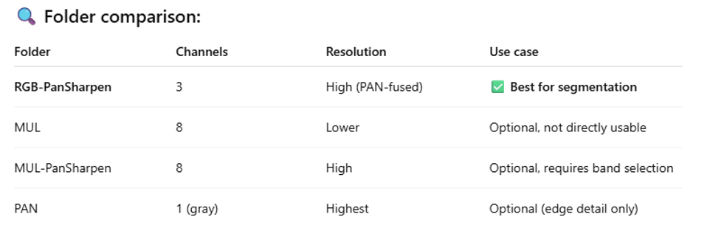
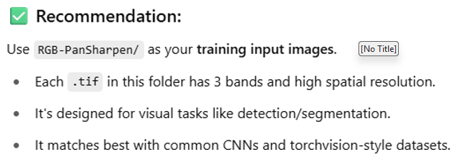
Image Types
Data contains 4 image types: 1) MUL, 2) MUL-PanSharpen, 3) PAN, and 4) RGB-PanSharpen
Per ChatGPT => RGB-PanSharpen need be usen for the training

Slide 6
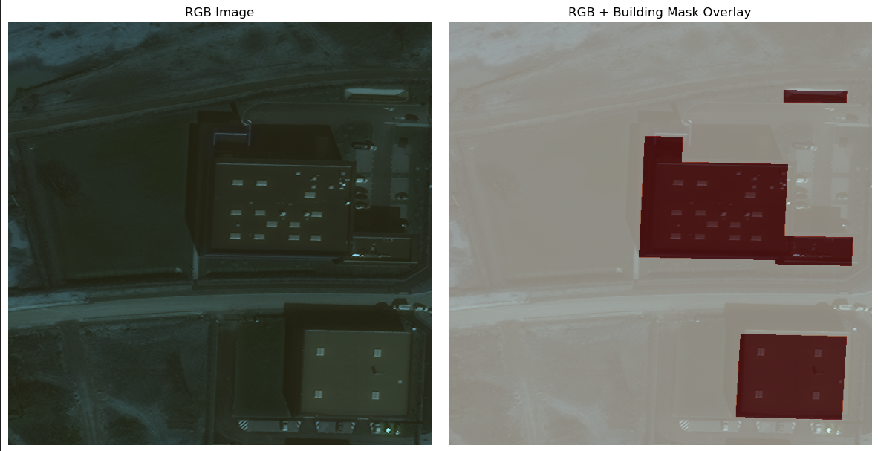
Visualization of building masks
Building?

Slide 7
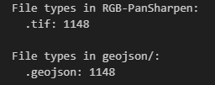
Files Types
All RGB images are tiff files
Building segmentation mask inside geojson files

Slide 8
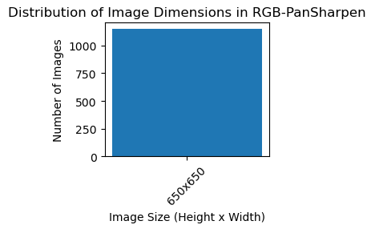
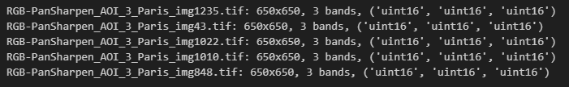
Image Size
All RGB tiff images are of the same resolution 650 x 650 pixels

Slide 9
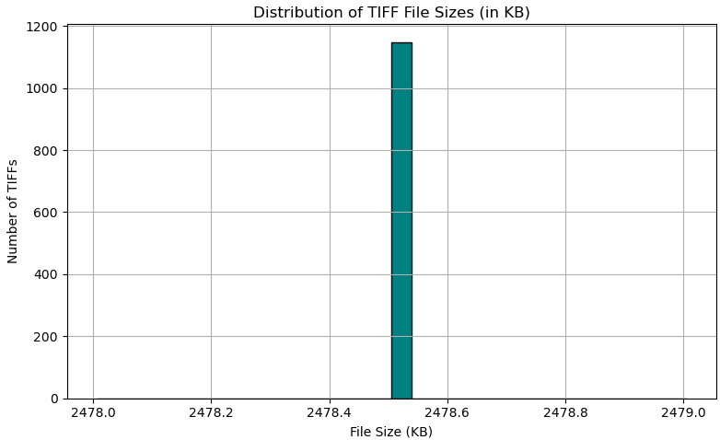
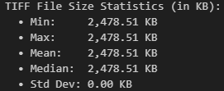
Image File Size
All RGB tiff image files are of the same size = 2478.51 KB

Slide 10
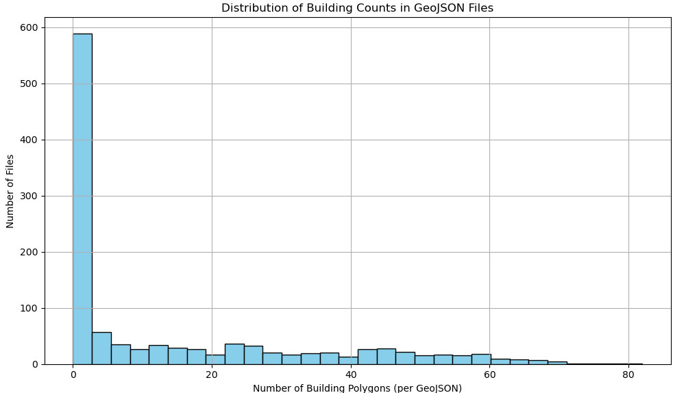
Distribution of Mask Counts

Slide 11
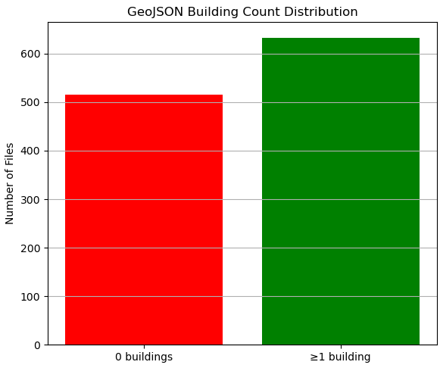
Distribution of Zero & Non-Zero Masks Counts
Images without buildings = backgrounds

Slide 12
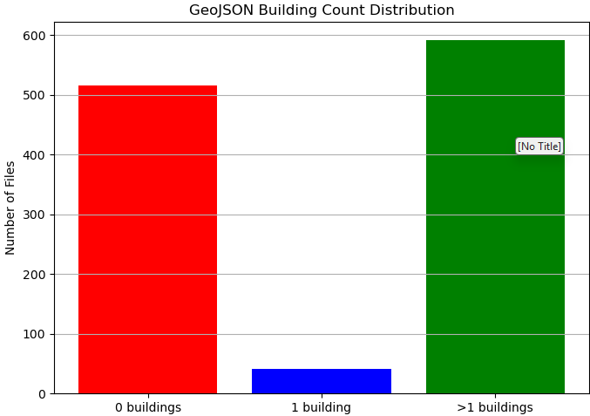
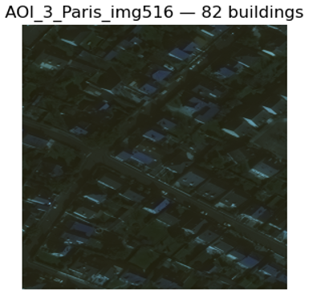
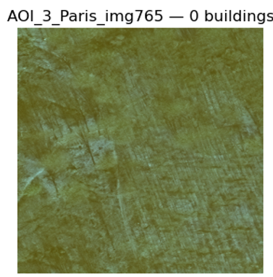
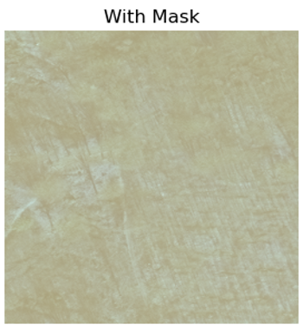
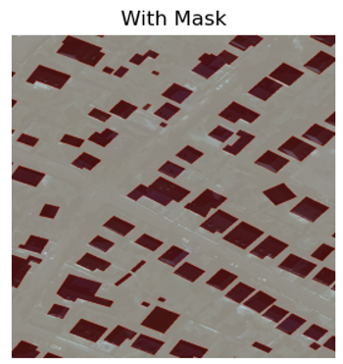
Distribution of Zero & One & Non-Zero Masks Counts
Data of background versus “signal” is balanced
Example 2
Example 1

Slide 13
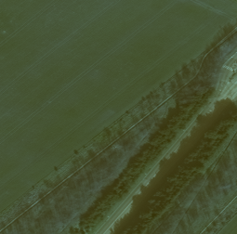
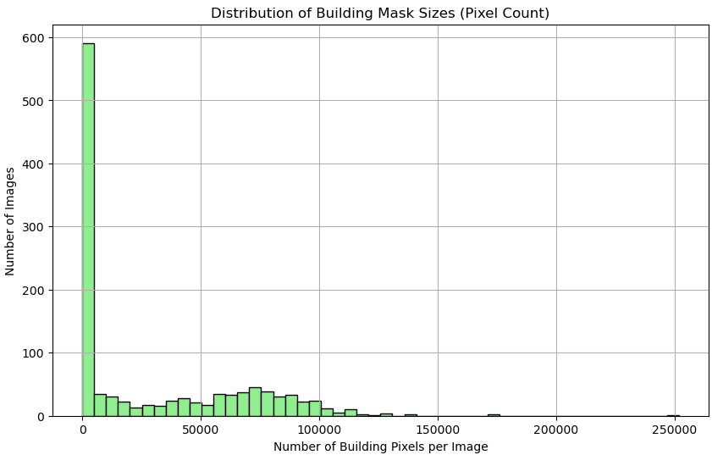
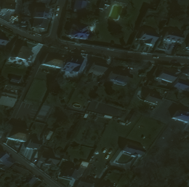
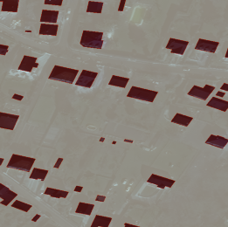
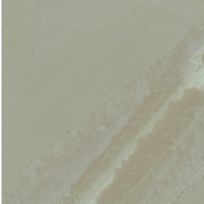
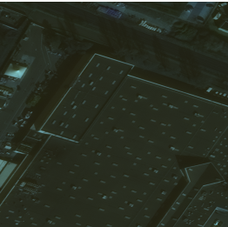
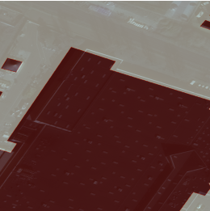
Distribution of Mask Sized (Pixel Count)

Slide 14
Task 1.2 : Data Preprocessing

Slide 15
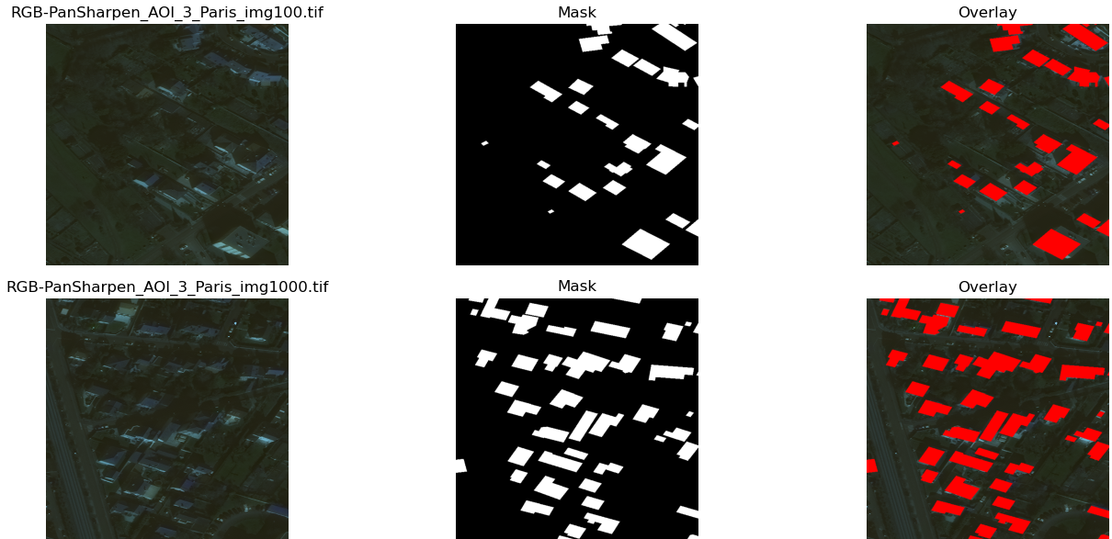
Geojson Files Conversion
Geojson files were converted from geojson type to png mask images
0 (black) represents background
1 (white) represents building mask

Slide 16
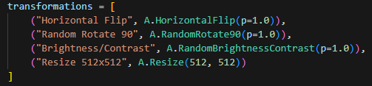
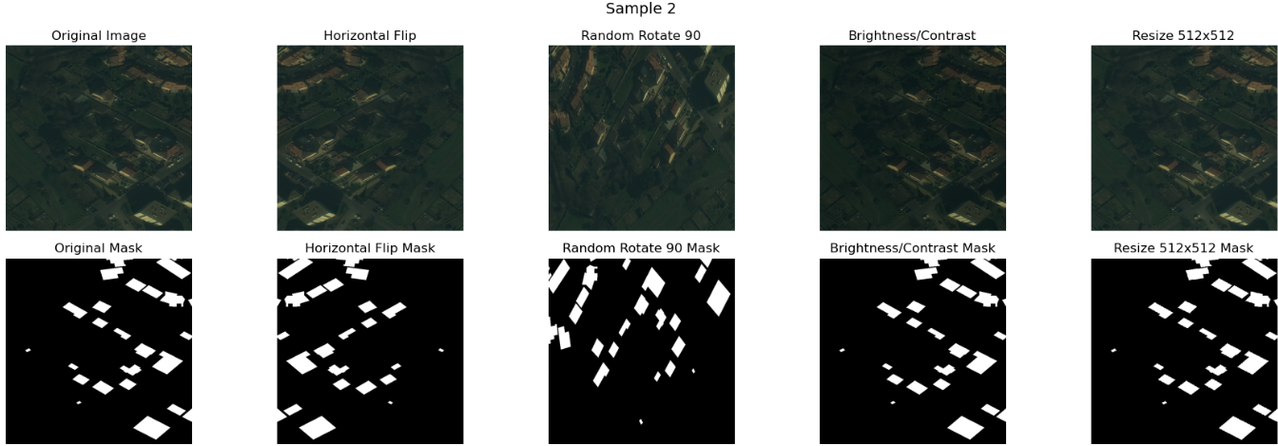
Augmentation Visualization

Slide 17
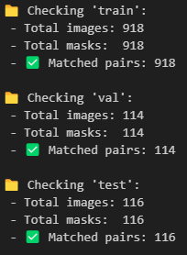
Train/Valid/Test Split (0.8/0.1/0.1)

Slide 18
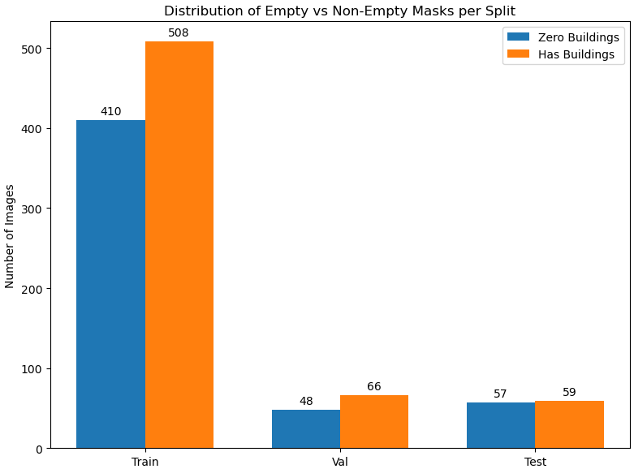
Train/Valid/Test Masks Distribution
Balanced for all sets

Slide 19
Task 1.3 : Training

Slide 20
Model - SegFormer
Article: https://arxiv.org/pdf/2105.15203
Open-source code: https://huggingface.co/docs/transformers/model_doc/segformer
Year: 2021
Source: CVPR

Slide 21
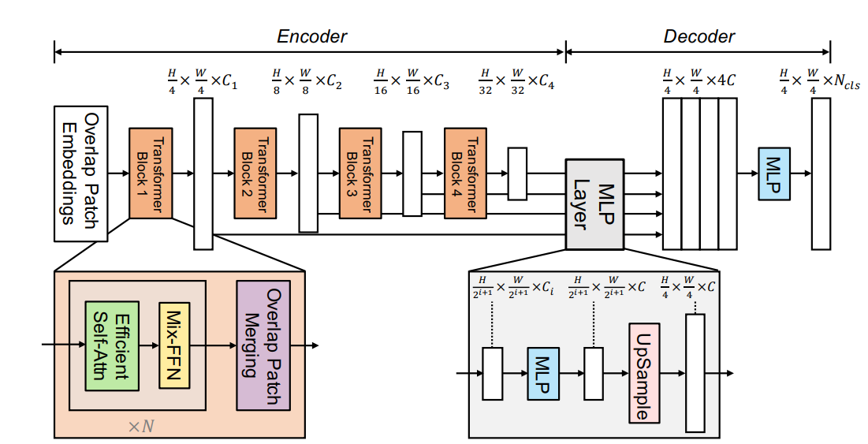
Model – SegFormer - Architecture

Slide 22
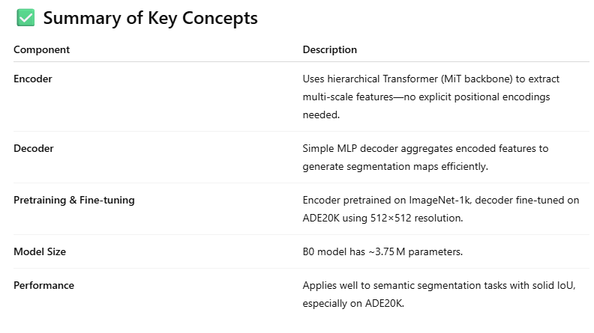
Model – SegFormer - Architecture

Slide 23
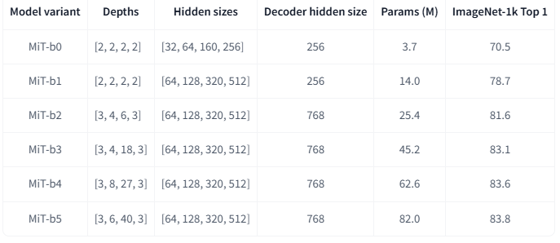
Model – SegFormer – Model Parameters
Used B0

Slide 24
Why SegFormer architecture was selected?
Open source in Hugging face
User friendly wrapper for training
Light, fast and efficient - can be executed on personal PC
Good accuracy due to attention mechanism and transformer-based features
Already pretrained, no need to start from scratch
Work with tiff satellite images
Income resolution need be 512 x 512 is close to the data (650 x 650)

Slide 25
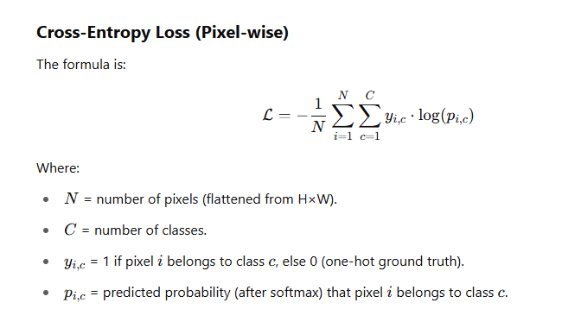
Loss

Slide 26
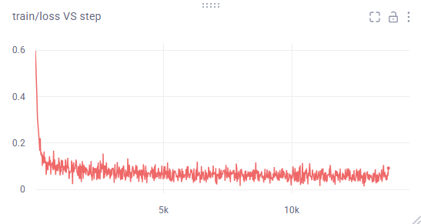
Training Set Monitoring
Good convergence
stabilization
https://www.comet.com/paster/building-segmentation/e646ee65f8ec451ebe9fbffaf7022f2a?compareXAxis=step&experiment-tab=panels&showOutliers=true&smoothing=0&xAxis=step

Slide 27
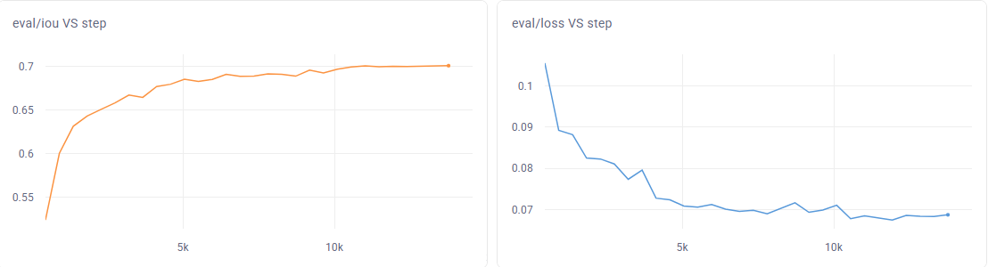
Validation Set Monitoring
IOU ~ 0.7 => strong performance
No overfitting, stabilization
https://www.comet.com/paster/building-segmentation/e646ee65f8ec451ebe9fbffaf7022f2a?compareXAxis=step&experiment-tab=panels&showOutliers=true&smoothing=0&xAxis=step

Slide 28
Task 1.4 : Inference

Slide 29
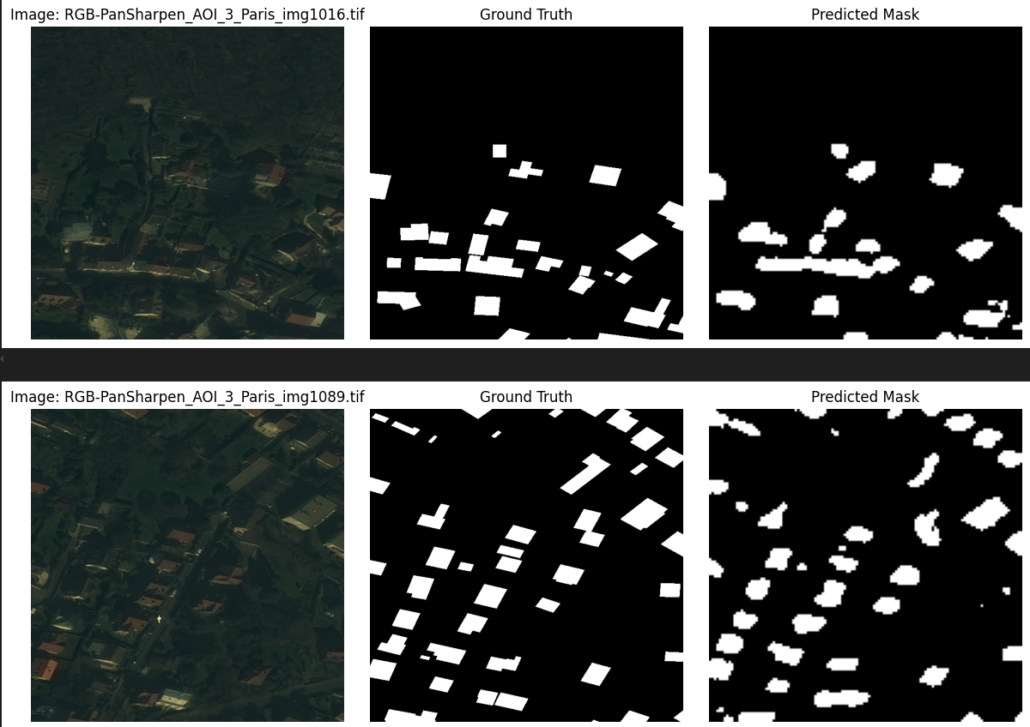
Prediction Visualization – Rounded Edges
The border and edges are rounded and blurred,
not sharp

Slide 30
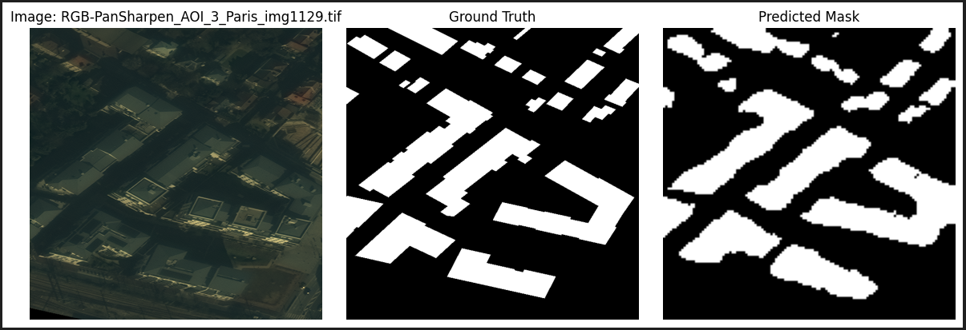
Prediction Visualization – Rounded Edges
The border and edges are rounded and blurred are not sharp

Slide 31
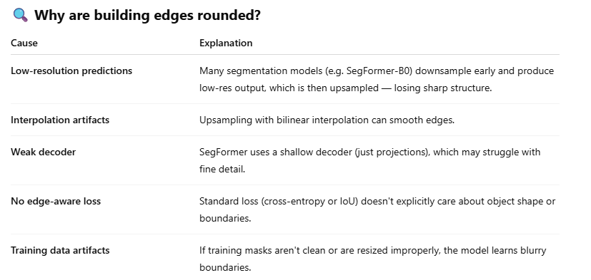
Prediction Visualization – Rounded Edges

Slide 32
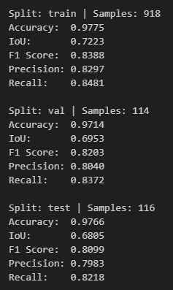
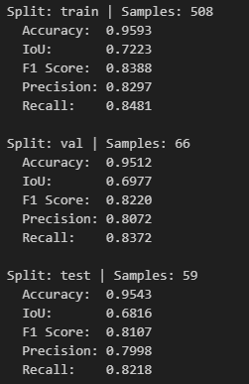
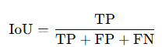
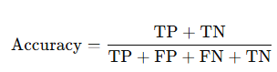
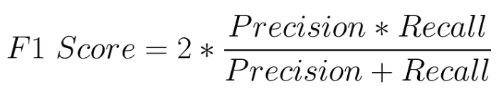
Prediction Summary
Images without building count = 0
All images (mean values)
Performance Is Consistent With and Without Empty Images
Accuracy is very high (~96–97%) because your DB is dominated by background pixels, which are much easier to predict than building pixels (TN is high).
Medium overlapping between predicted mask with the ground truth mask
Model overall is good
Low FP
Low FN
Precision = TP / (TP + FP)
TN = background
Recall = TP / (TP + FN)

Slide 33
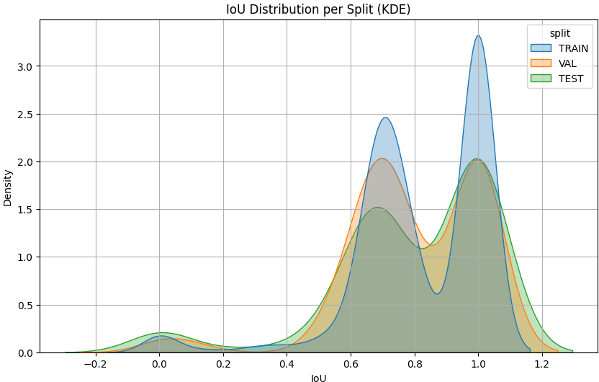
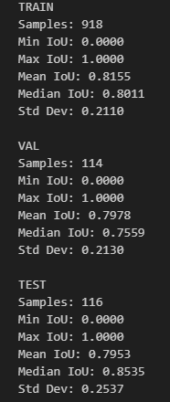
IoU Statistics
All image
images where buildings are NOT present in ground truth
images where buildings are present in ground truth

Slide 34
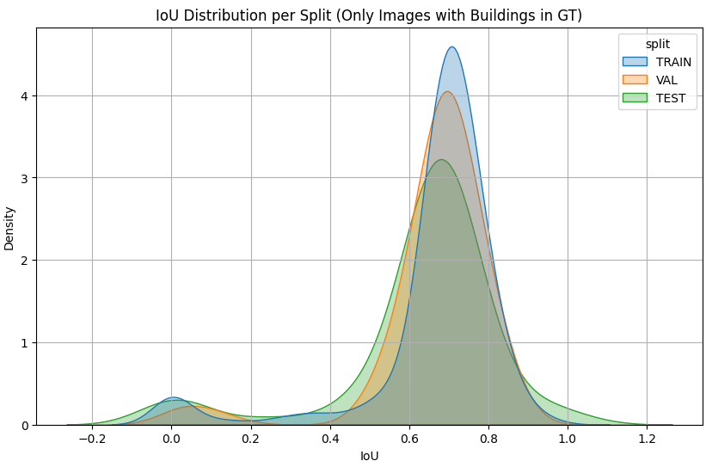
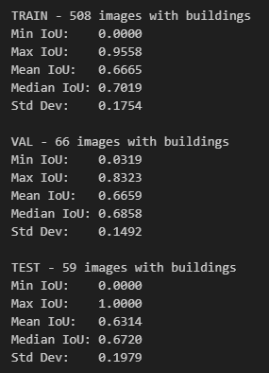
IoU Statistics
Images with buildings in GT
Still, we have second subgroup

Slide 35
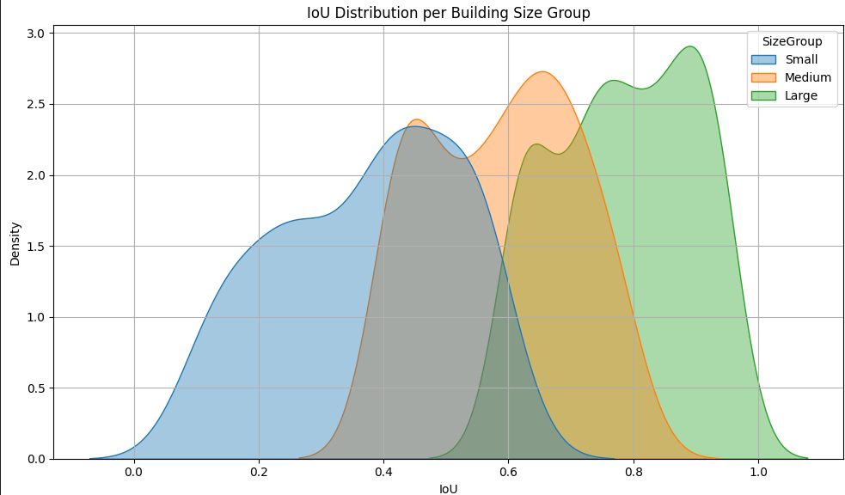
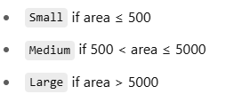
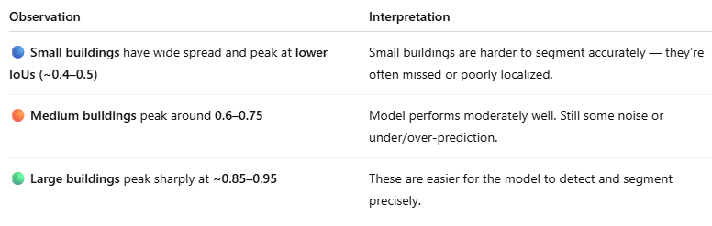

IoU Statistics
Train + Vali + Test Sets = cumulative
IoU is smaller for small buildings

Slide 36

Building Size Distribution – Train + Valid + Test Sets

Slide 37

Building Size Distribution – Train , Valid , Test Sets
Unbalanced data for building size distribution among the sets.

Slide 38

Building Size Distribution vs IoU
Theoretically, if the training set contains mostly small buildings, the model should become better at predicting them.
However, here the results show the opposite — IoU is lowest for small buildings.
Main reasons why the model may still fail despite being trained on many small objects:

Slide 39



Building Size Distribution vs IoU

Slide 40


Visualization of the Best IoU Predictions

Slide 41

Visualization of the Worst IoU Predictions (GT include Buildings)

Slide 42

Visualization of the Worst IoU Predictions (GT without Buildings)

Slide 43

Conclusions
SegFormer is a lightweight, attention-based transformer model that handles aerial imagery well even with limited training time.
IoU for test set is high (0.68) but lower than in article:
The reason is we used B0 model which has ~3.7M parameters versus B5 model (~82M parameters).
B0 is meant for edge or fast inference, not accuracy.
B5 was used in the paper to achieve SOTA on Cityscapes.
I missed normalization, which can be critical here.
In train.py Normalization part was added as comment; you can apply it.

Slide 44

Conclusions - Improve IoU for Small Buildings

Slide 45

Conclusions - Improve IoU for Small Buildings

Slide 46

Conclusions - Improve IoU for Small Buildings

Slide 47

Conclusions - Improve IoU for Small Buildings

Slide 48


Conclusions - Improve Edges Sharpness

